Slide 1


Horizon 2020
“Unleashing Student Potential”
School Board Retreat Follow-Up
Strategic Plan Recommendations
June 13, 2013

Slide 2
At the retreat, we proposed moving from our current model…
Goal 1
Goal 2
Goal 3
Goal 4
Goal 5
Priority
Priority
Priority
Priority
Priority
Priority
Priority

Slide 3
…to one student-centered goal
One Student-Centered Goal - SMART Format (Strategic, Measurable, Attainable, Results-Oriented, Timebound)
Objective 1
Objective 2
Objective 3
Objective 4
Objective 5
Objectives
Our Commitments for How We Intend to Achieve Our Goal
Notes:
Commitment

Slide 4
Our Proposed Goal and Objectives
One Student-Centered Goal
By 2020, 97 % or more of students will graduate having mastered the skills they need to succeed as 21st century learners, workers, and citizens
Objective 1
We will engage every student
Objective 2 We will implement balanced assessments
Objective 3 We will improve opportunity and achievement
Objective 4 We will create and expand partnerships
Objective 5 We will optimize resources
Our Objectives
Our Commitments for How We Intend to Achieve Our Goal

Slide 5
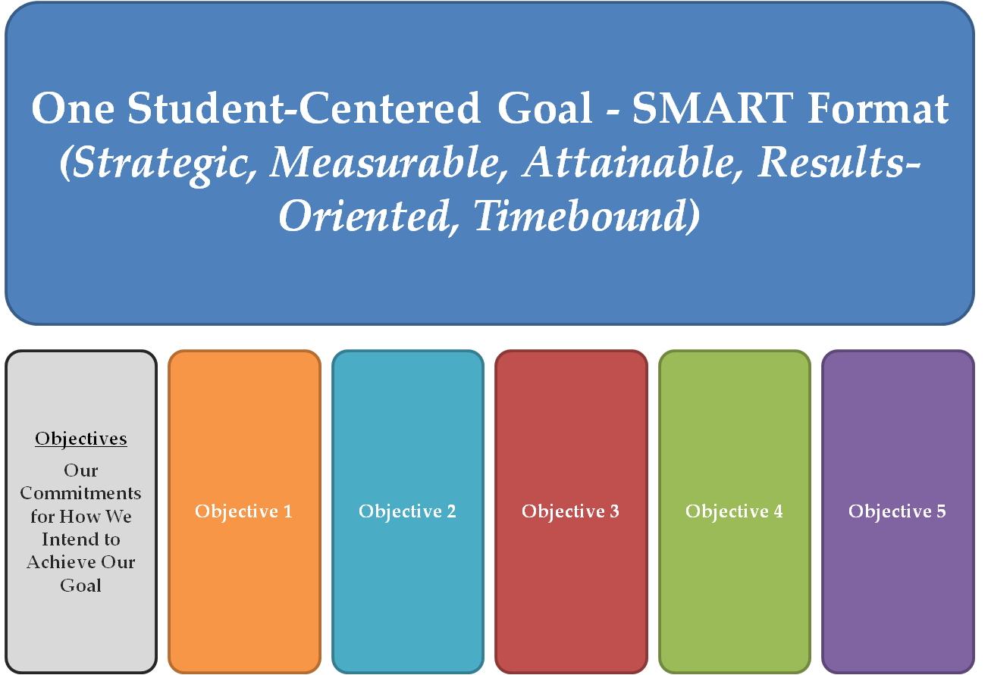
How We Will Measure the Goal
Baseline Measure
and
Quality Assurance Indicators

Slide 6
Baseline Goal Measure
On-time graduation rate for a given class and enrollment groups (includes all diploma types, GEDs, and Certificates of Completion)

Slide 7
Quality Assurance Indicators…
Performance Tasks
Advanced Studies Diplomas
Industry Certifications
Arts, Extra-Curriculars, Sports
Mentorships and Internships
Volunteer Activities
CWRA
College Retention Rate
Other?

Slide 8
Narrowing Potential Priorities
Priority
Priority
Priority
Priority
Priority
Focus of Retreat :
Narrowing the List of Priorities
Priority
Priority
Priority
Priority
Priority

Slide 9
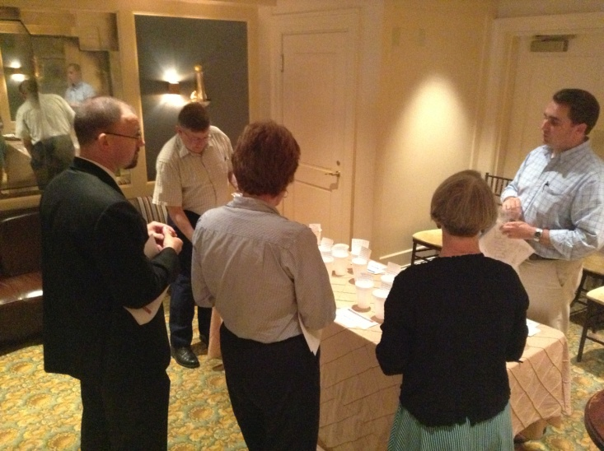
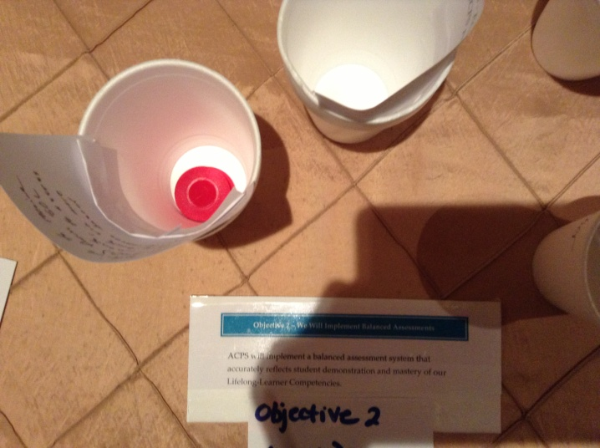
Narrowing the Priorities
Red = Consensus
Blue = 3 or More
White = 1 Individual

Slide 10
Objective 1 – We Will Engage Every Student
“All teachers and schools will engage every student in meaningful, authentic and rigorous work through the use of instructional best practices and supportive technologies that will motivate students to be self-directed and inquisitive learners. “
Potential Priorities
Define, develop, and implement effective teaching practices that maximize rigor and meaningful engagement for all students AND expand PD for teachers and administrators…(5R)
Integrate supportive technologies and the use of contemporary learning spaces into the instructional program delivery (4B)

Slide 11
Objective 2 – We Will Implement Balanced Assessments
“ACPS will implement a balanced assessment system that accurately reflects student demonstration and mastery of our Lifelong-Learner Competencies. “
Potential Priorities
Other: Develop ACPS graduation seal to reflect division graduation requirements (5R)
Other: Board will strive to receive State waiver(s) from SOL testing requirements, to assess Albemarle students via more rigorous, performance-based assessments (5R)

Slide 12
Objective 3 – We Will Improve Opportunity and Achievement
“ACPS will improve opportunity and achievement for all students and enrollment groups.“
Potential Priorities
Measure and report student performance on key metrics for work and college readiness from K through high school AND monitor and report student performance on ACPS division-wide performance task assessments (5B)

Slide 13
Objective 4 – We Will Create and Expand Partnerships
“ACPS will create and expand partnerships with parents, community and business leaders to fulfill their essential roles as actively engaged partners in supporting student achievement and outcomes for student success “
Potential Priorities
Implement a comprehensive mentorship and internship program throughout the school division (5W)
Use strategic communications to invest the full community in supporting student achievement and outcomes for student success (2W)

Slide 14
Objective 5 – We Will Optimize Resources
“ACPS will optimize all resources to achieve the school division’s strategic goal and outcomes for student success“
Potential Priorities
Other: Obtain funding from Board of Supervisors and/or community to support Board priorities and Horizon 2020 strategic plan – World Languages Program (4B)
Ensure health and safety of the school community (2W)

Slide 15

Next Steps:
June 27th - Board Work Session
  Finalize Priorities
  Adopt New Plan
July/August - Summer Alignment
  Leaders Align School and Department Improvement Plans and KPIs
July/August – Communications Campaign

